Slide 1
Location Based Advertising & Marketing System
Sappu Savari
I S Dewasurendra – 139160M
Supervised by: Mr. Saminda Premaratne
Faculty of Information Technology
University of Moratuwa

Slide 2
Agenda
Sappu Savari - Introduction
Background and Motivation
Aims and Objectives
Proposed System
Existing Issues
Technology Stack
Analysis and Design Consideration
Implementation
Conclusion & Further Works

Slide 3
Sappu Savari - Introduction
Integrated Location Based Services.
Mainly targeted for smart mobile device users.
Most suitable for mid range sellers and buyers.
An android mobile application and a web application.
System can be accessed by smart mobile devices and computers via Internet.
The Location would be gathered using Geolocation API (IP/GPS).

Slide 4
Sappu Savari - Introduction - Cont.
Users can post advertisements.
Users can search advertisements.
Users will be automatically notify when there are any suitable items available.
Also provide notifications on near by sellers.
Users can rate products, overall rating will calculate by the system.
Users can comment or give reviews.
Users can communicate by sending messages each other.

Slide 5
Background and Motivation
People are gradually moving to no paper concepts
Early ages people used to post advertisements in news papers.
People always interested in selling their old items rather than throwing away.
Several years back people sold their old lands and vehicles, but now mobile phones, TV, laptops, tabs, fans and more are being sold.

Slide 6
Background and Motivation – Cont.
Smart mobile device usage is higher than ever, and most of the time these devices is being used several times in a day.
Lack of Location Based Services usage for marketing purposes.
Location Based Services are not available in most of the Existing marketing systems.

Slide 7
Background and Motivation – Cont.
People spends time to search relevant items to buy.
Need to browse every time to check the newly updated posts – not real time.
No reliable way to communicate between buyers and sellers.
Have to call or email.
Increasing frauds day by day.
Users sell broken items or stolen items – no way to rate or give reviews about the items to be sold.

Slide 8
Background and Motivation – Cont.
Have to call buyers/sellers and make appointments.
When the buyers meets the right product to buy, he/she have to call and make appointment to meet the buyer/seller and buy/sell the item.
Narrow opportunities and less chance to the buyers and sellers.
Buyers and sellers only focused to the near by areas, this narrow down the opportunities for business.

Slide 9
Aim and Objectives
The expected outcome of this research is to provide a comprehensive software system to support advertising and marketing.
For Seller,
Provide wider range buyers.
Better way to communicate with buyers.
For Buyer,
Automated search services.
Automated location services.
Facilitate rating and reviews.
Minimize frauds.
Easy communication with sellers.

Slide 10
Proposed System
The system mainly using web protocols which means system functions as a web oriented system via internet.
Every user need to create an authentication to save and retrieve relevant information.
Uses Geo location API, so system can get the location even on IP based information(less accurate on IP based information and high accuracy when GPS is available)

Slide 11
Proposed System – Cont.
Sellers can post their product items or services which they planning to sell.
Buyers can search available items and services.
According to the searches system notify when there are new items are available.
Notify when interested sellers are near by.
Facilitate provide comments and rating.
Messaging platform for communications.

Slide 12
Existing Issues in Systems
International,
Closs 5 – developed by Ebay. Integrated with Location Based Services to categorize the advertisements. Also provide online chat with other party.
Yardsale – developed by Apple corporation. Sellers can set a fixed location and those locations are listed down in a grid view on buyers mobile devices when searched.
Local,
Ikman.lk – can advertised over many product categories, location categorized.
HitLanka.lk – advertisements are categorized over product categories and location.

Slide 13
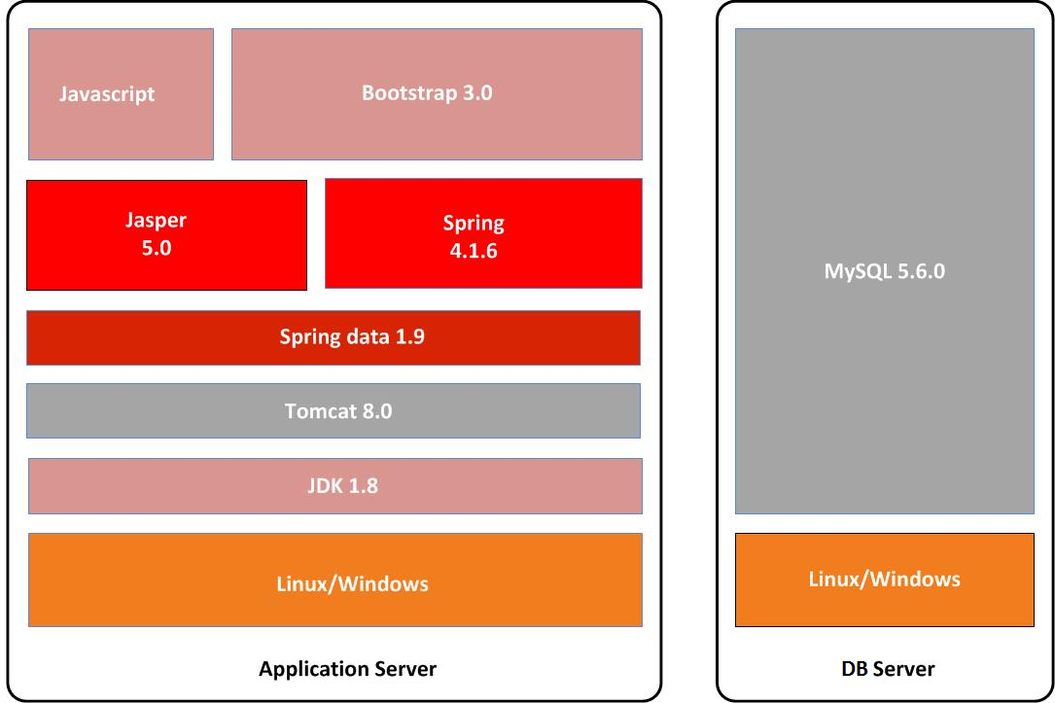
Technology Stack

Slide 14
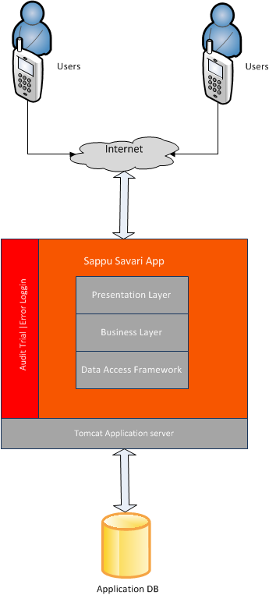
Analysis and Design Considerations

Slide 15
Analysis and Design Consideration – Cont.
UI Considerations - Model View Controller (MVC) Pattern
Data Model Design - MySQL database
Uses of Design Pattern – DAO/MVC/ Factory
Connection Pooling - spring data framework
Transaction and Rollback - DAO layer
Concurrent Access – Version Controlling
Clustering Support – JVM (singleton instance)
Logging Facilities - Log4j logging framework
Audit Facilities – audit table columns
Security – spring security
Notes:
Data access Object (DAO) pattern – Spring data - data layer
Factory Pattern – spring framework.
Singleton Pattern – database layer
MVC pattern – Presentation layer.

Slide 16
Implementation
Scheduler Service
Step 1: execute search requests and fetch selected products
Step 2: Start LOOP
fetch Follow Seller Selections
Start LOOP
IF
(follow seller == searched product owner)
calculate distance
IF
(distance < 1)
fire high priority notifications;
END IF
END IF
End LOOP
End LOOP

Slide 17
Implementation – Cont.
Calculating overall rating
Formula
Overall Rating = Total Rating/No of Rating
* for a item wise
steps for calculating overall rating
Step 1: Fetch list of rating product wise
Step 2: Initialize variable for sum and count
Step 3: Begin Loop
sum = sum + rating;
count = count + 1;
End Loop
Step 3: IF
sum>0 and count>0
Return sum/count
End IF

Slide 18
Implementation – Cont.
Generate Distance Notification
haversine Formula
a = sin²(Δφ/2) + cos φ₁ ⋅ cos φ₂ ⋅ sin²(Δλ/2)
c = 2 ⋅ atan2( √a, √(1−a) )
d = R ⋅ c
φ is latitude, λ is longitude
R is earth’s radius (mean radius = 6,371km)
*the earth is very slightly ellipsoidal; using a spherical model gives errors typically up to 0.3%
Implemented using Java Math library packages.

Slide 19
Implementation – Cont.
Used open source technologies and development tools.
Eclipse (Mars)
Mysql Workbench
Ireport
For the Data layer - MySQL database
Data layer implementation – Java
For further functionalities such as connection pooling, maintain scalability - Spring data JPA framework.
Business layer - Java and Spring framework.
The presentation layer will be developed using HTML5, JSP, JSTL, Jquery, Json and BootStrap.
Report generations - Jasper reporting with Ireport.

Slide 20
Conclusion & Further Works
Conclusion
The newly proposed system will be well benefited to the people who spend a busy schedule in their life.
Automated searching service will save the time spending on browsing through the posted advertisements.
Location based services will save the time spending on scheduling time and venue for meet the seller.
Users notify automatically when the best matching seller or buyer comes nearby, so the user will be free of tension and stress of searching the proper buyer or seller to contact.

Slide 21
Conclusion & Further Works – Cont.
System notify buyer or seller and shortest path details to find the other party.
Until you find the best matching seller or buyer the system will continue finding.
Minimize the frauds by ranking; Also helps for future references which help other buyers to find better products or services.
Reviews and commenting facility will provide more information about the seller or the products.
Messaging facility will ease up the communication between buyer and seller.

Slide 22
Conclusion & Further Works – Cont.
Concerns
User need a average computer literacy to use the system.
User will need a smart phone with internet connection and location facilities to experience a reliable service.
Mobile application should constantly up and running to get the proper location based services.
Location based services and internet usage will drain the mobile phone battery.
Application services will be needing a high performance web servers and database servers to serve no of users at once.
Some users may provide false details or bad rating purposefully which we cannot validate.

Slide 23
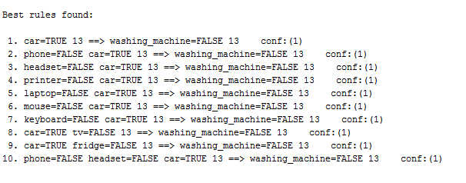
Conclusion & Further Works – Cont.
Further Works
Android service to fetch location information and provide task bar notifications.
Integrating Data mining
Integrate weka java API.
Using Apriori algorithm, associate model.

Slide 24
Demonstration
Isuru.dewasurendra@gmail.com
sunil@gmail.com
Phone – Samsung Note3
kamal@gmail.com
Car - BMW X1 2011
ranjith@gmail.com

Slide 25
Location Based Advertising and Marketing System – Sappu Savari
Thank you
I S Dewasurendra – 139160M
Supervised by: Mr. Saminda Premaratne
Faculty of Information Technology
University of Moratuwa

